Slide 1
Simulation & Physics
2016-2017

Slide 2
geometry of dotproduct

Slide 3
Simulation: bouncing
Math

Slide 4
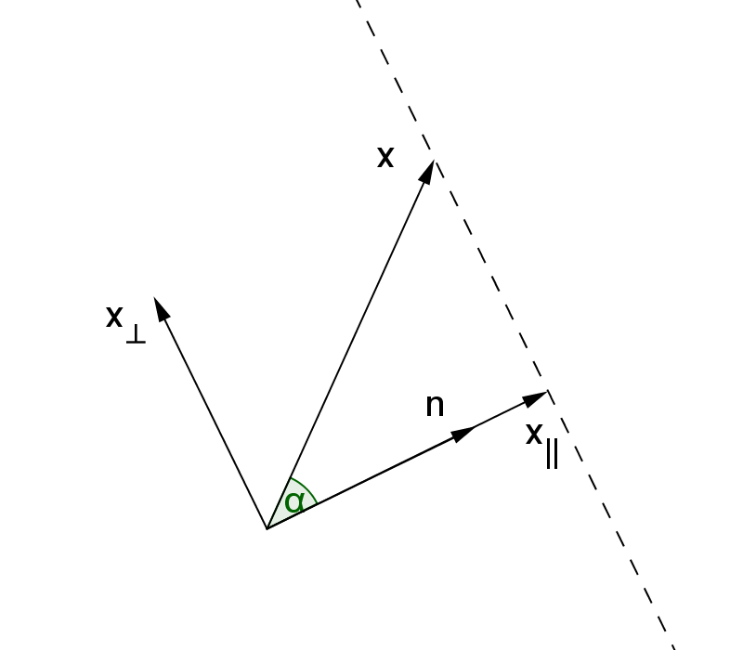
geometry of dotproduct
1
Given two vectors x and n

Slide 5
geometry of dotproduct
2
Also from figure: x||= λn

Slide 6
geometry of dotproduct
1
2
Calculate λ from these 2 formulas

Slide 7
Calculate λ

Slide 8
components parallel and perpendicular
1
2
3

Slide 9
Example components
1
2
3
Note: because

Slide 10
formula components

Slide 11
use normalized vector
When n is normalized:

Slide 12
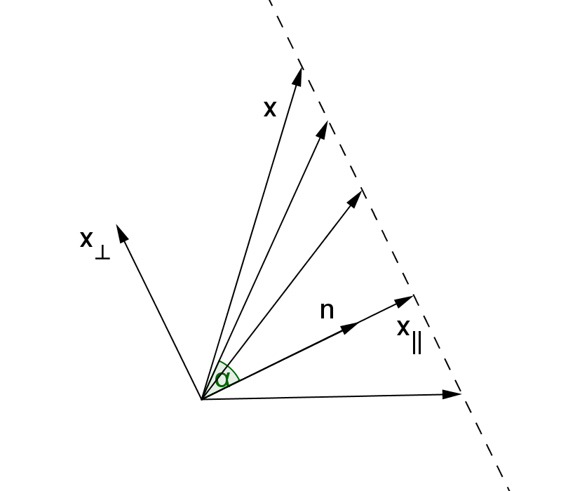
normal equation 2D
Vectors x with the same projection onto vector n
Gives:
Let
and
In 2D this represents a line

Slide 13
line constant c
Given a point P = (p₁, p₂) on line l : ax + by = c

Slide 14
abstract form of equation
Given normalvector:
Given place vector:
Normal equation of the line perpendicular
to vector n through point P with place vector p:

Slide 15
Example
Given normal vector:
Given place vector:
Normal equation of the line perpendicular
to vector n through point P with place vector p:
7x – 3y = –1

Slide 16
exercise
Sowiso question 2.7.3
When finished:
Make the exercise again with pen and paper and check the results of your neighbor.
(not with the same values as in the first question)

Slide 17
normal equation 3D
Vectors x with the same projection onto vector n
Gives:
Let
and
In 3D this represents a plane

Slide 18
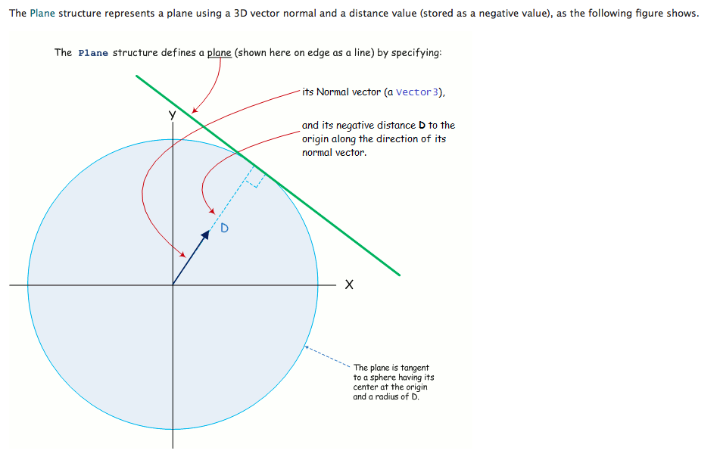

Slide 19
plane constant d
Given a point P = (p₁, p₂, p₃) on plane V: ax + by + cz = d

Slide 20
abstract form of equation
Given normalvector:
Given place vector:
Normal equation of the plane perpendicular
to vector n through point P with place vector p:

Slide 21
3D geometry
Cross product

Slide 22
Perpendicular vector 3D

Slide 23
Perpendicular vector 3D
and many more!

Slide 24
Perpendicular to 2 vectors
n
b
a
5n₁ + 3n₂ - 3n₂ = 0
3n₁ – n₂ + 4n₂ = 0
solution?

Slide 25
Cross product (3D only)
Definition:
the crossproduct a × b of two vectors a and b is a vector perpendicular to both a and b
It can be calculated by the formula:

Slide 26
Cross product example
Now you!
Check that the answer is perpendicular to the given vectors
Discuss your solution with your neighbour

Slide 27
vector geometry
Distance point to line and plane

Slide 28
distance point to line 2D
Line l: x – 2y = 5 and Point P(-3,1)
P
Calculate the distance from P to l using vector geometry
l
S
Give the vector equation of line m perpendicular to line l through point P
Find the intersection S between l and m
Calculate the distance from P to S
m

Slide 29
distance formula (1)
d(P,l) = distance from P to l
Find the normal equation of line l:
Find a vector equation of line m perpendicular to l, through P
m: x = p + λ n
Find the intersection S:
s = p + λ n and s ∙ n = c

Slide 30
distance formula (2)
s = p + λ n and s ∙ n = c
Substitution gives:
(p + λ n) ∙ n = c
Solve for λ:
p ∙ n + λ n ∙ n = c
λ n ∙ n = c – p ∙ n
Conclusion for intersection S:

Slide 31
distance formula (3)
We need the distance from p to s, so we need the length of s - p

Slide 32
Example
We calculate the distance from point P(2,0) to line m: −9x = −36.
Notes:
d(A,l)=|c−n^⋅A⃗ |=−4−(−10)⋅(20)=−4−(−2+0)=−2

Slide 33
exercise
Sowiso question 2.9.2
When finished:
Make the exercise again with pen and paper and check the results of your neighbor.
(not with the same values as in the first question)

Slide 34
distance formula (2a)
s = p + λ n and s ∙ n = c
with n normalized
Substitution gives:
(p + λ n) ∙ n = c
Solve for λ:
p ∙ n + λ n ∙ n = c
But n ∙ n = 1, because n is normalized:
p ∙ n + λ = c
So:
λ = c – p ∙ n
Conclusion for intersection S:
s = p + (c – p ∙ n) n
with n normalized

Slide 35
distance formula (3a)
s = p + (c – p ∙ n) n
We need the distance from p to s, so we need the length of s – p
|s – p| = |(c – n ∙ p) ∙ n| = | c – n ∙ p | ∙ |n| = | c – n ∙ p |
|n| = 1, because n is normalized
d(P, l) = | c – n ∙ p |
with n normalized

Slide 36
Example
Again, we calculate the distance from point P(2,0) to line m: −9x = −36.
This time, normalize the normal first

Slide 37
distance point to plane 3D
Plane V: x – 2y + 3z = 5 and Point P(-3,1,4)
P
l
Calculate the distance from P to V using vector geometry
S
m
Give the vector equation of line m perpendicular to plane V through point P
Find the intersection S between V and m
Calculate the distance from P to S

Slide 38
distance formula (1)
Find the normal equation of plane V:
Find a vector equation of line m perpendicular to V, through P
m: x = p + λ n
Find the intersection S:
s = p + λ n and s ∙ n = c
Substitution gives:
(p + λ n) ∙ n = c
Solve for λ:

Slide 39
distance formula (2)
Conclusion for intersection S:
We need the distance from p to s, so we need the length of s – p
The same formula
as d(P,l) in 2D!

Slide 40
exercise
Sowiso question 2.9.5
When finished:
Make the exercise again with pen and paper and check the results of your neighbor.
(not with the same values as in the first question)

